Slide 1
GRADING:
First essay 25%
Second essay 35%
Exam 25%
Attendance and Participation 15%

Slide 2


Slide 3
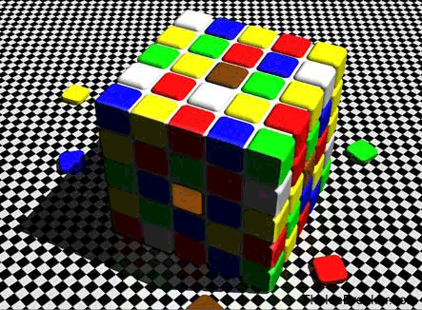

Slide 4
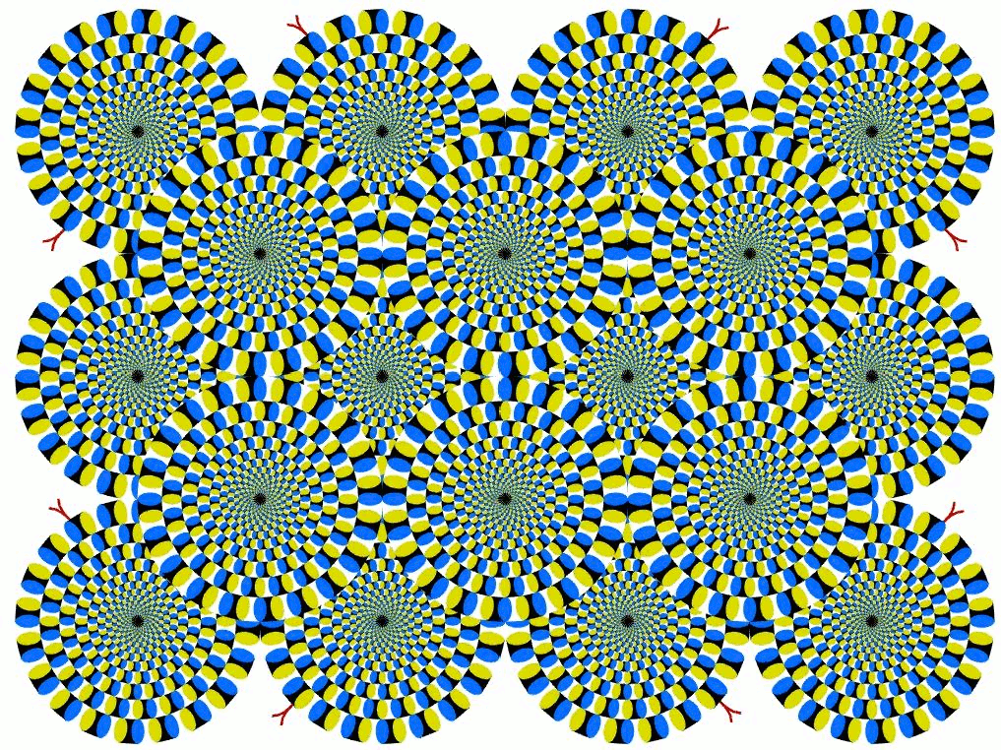

Slide 5
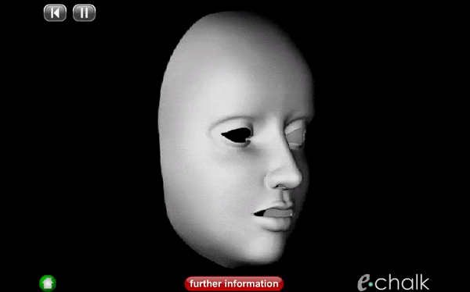
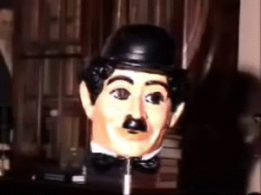

Slide 6


Slide 7
Introduction to Philosophy
Hume’s Standard of Taste
Of the Standard of Taste was a seminal essay on aesthetics that is innovative because it requires Hume to address the apparent relativity of taste, a conclusion that follows from his own assumption that the "good" or "beauty" of a good work of art is identical with the positive human responses it generates.
The essay's focus on the subject (the viewer, the reader) rather than the object (the painting, the book) is typical of the British "sentimentalists" or moral sense theorists of the eighteenth century.
Hume begins with the observation that there is much variety in people's taste (or the aesthetic judgments people make).
However, Hume argues that there is a common mechanism in human nature that gives rise to, and often even provides justification for, such judgments. He argues that this still leaves room for the ability to refine one's aesthetic palate.
Hume took as his premise that the great diversity and disagreement regarding matters of taste had two basic sources - sentiment, which was to some degree naturally varying, and critical facility, which could be cultivated. Each person is a combination of these two sources, and Hume endeavours to delineate the admirable qualities of a critic, that they might augment their natural sense of beauty into a reliable faculty of judgment.

Slide 8
Introduction to Philosophy
Hume’s Standard of Taste
empiricism
relativism
sentimentalism

Slide 9
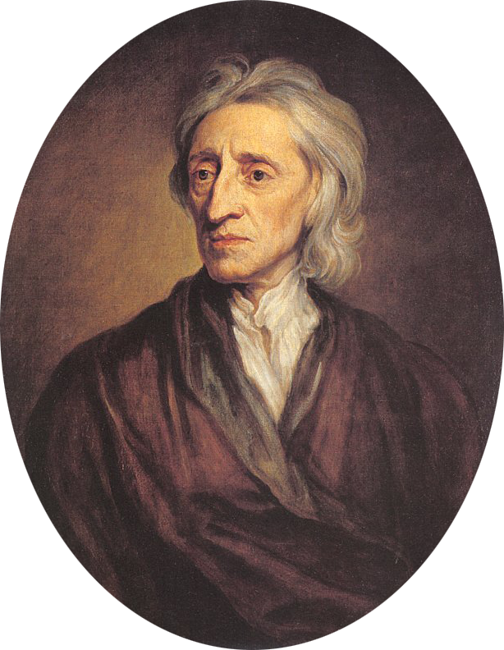
Introduction to Philosophy
Locke Human Understanding

Slide 10
Introduction to Philosophy
Locke Human Understanding
John Locke
1632 – 1704
English philosopher and physician
Enlightenment
"Father of Liberalism“
British empiricists
social contract theory
Republicanism
His contributions to classical republicanism and liberal theory are reflected in the United States Declaration of Independence.

Slide 11
Introduction to Philosophy
Locke Human Understanding
Book I
The main thesis is that there are "No Innate Principles", by this reasoning:
If we will attentively consider new born children, we shall have little reason to think that they bring many ideas into the world with them
and that "by degrees afterward, ideas come into their minds.“
Book I of the Essay is devoted to an attack on nativism or the doctrine of innate ideas. Locke allowed that some ideas are in the mind from an early age, but argued that such ideas are furnished by the senses starting in the womb: for instance, differences between colours or tastes. If we have a universal understanding of a concept like sweetness, it is not because this is an innate idea, but because we are all exposed to sweet tastes at an early age.
One of Locke's fundamental arguments against innate ideas is the very fact that there is no truth to which all people attest. He took the time to argue against a number of propositions that rationalists offer as universally accepted truth, for instance the principle of identity, pointing out that at the very least children and idiots are often unaware of these propositions.

Slide 12
Introduction to Philosophy
Locke Human Understanding
... they (perceptions) are exactly the images and resemblances of something inherent in the subject: most of those of sensation being in the mind no more the likeness of something existing without us, than the names that stand for them are the likeness of our ideas, which yet upon hearing they are apt to excite in us.
What I have said concerning colours and smells may be understood also of tastes and sounds, and other the like sensible qualities; which, whatever reality we by mistake attribute to them, are in truth nothing in the object themselves, but powers to produce various sensations in us;

Slide 13
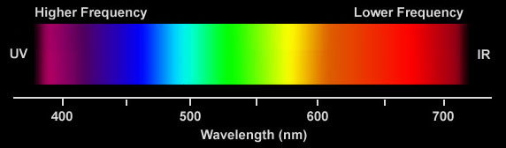
Introduction to Philosophy
Locke Human Understanding

Slide 14
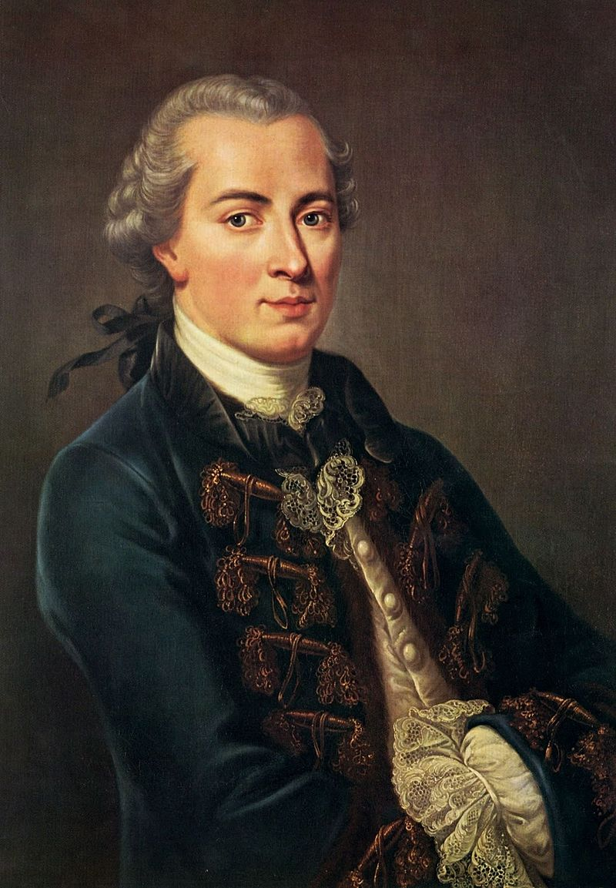
Introduction to Philosophy
Immanuel Kant Critique of Pure Reason

Slide 15
Introduction to Philosophy
Immanuel Kant Critique of Pure Reason
Immanuel Kant
1724 – 1804
German
Critique of Pure Reason
human mind creates the structure of human experience
space and time are forms of our sensibility
the world as it is "in-itself" is independent of our concepts of it
Critique of Practical Reason
reason is the source of morality
Critique of Judgment
aesthetics arises from a faculty of disinterested judgment

Slide 16
Introduction to Philosophy
Immanuel Kant Critique of Pure Reason
In one of Kant's major works, the Critique of Pure Reason (Kritik der reinen Vernunft, 1781), he attempted to explain the relationship between reason and human experience and to move beyond the failures of traditional philosophy and metaphysics. Kant wanted to put an end to an era of futile and speculative theories of human experience, while resisting the skepticism of thinkers such as David Hume. Kant regarded himself as ending and showing the way beyond the impasse which modern philosophy had led to between rationalists and empiricists, and is widely held to have synthesized these two early modern traditions in his thought.
Kant argued that our experiences are structured by necessary features of our minds. In his view, the mind shapes and structures experience so that, on an abstract level, all human experience shares certain essential structural features. Among other things, Kant believed that the concepts of space and time are integral to all human experience, as are our concepts of cause and effect. One important consequence of this view is that our experience of things is always of the phenomenal world as conveyed by our senses: we do not have direct access to things in themselves, the so-called noumenal world.

